Slide 1
Elastic Stack 8.8.x By Anand Kulkarni anand.kulkarni1@zensar.com

Slide 2
Table of Content
Module | Topic
Module 1: | Continuous Monitoring & Log Management
Module 2: | Introduction to Elastic Stack & its components
Module 3: | Applying Elastic Stack on springboot app
Module 4: | Beats
Module 5: | Logstash
Module 6: | Elastic Search
Module 7: | Kibana
Module 8: | Success stories & References

Slide 3
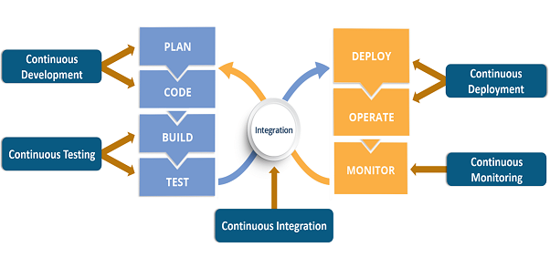
DevOps Life Cycle

Slide 4
Continuous Monitoring
Continuous Monitoring is the process of real time monitoring of the application & generate its visualization report dynamically.
Continuous Monitoring is an integral part of software development.
It is used to monitor the health of our application.
It is helpful in improvising overall application quality.

Slide 5
Types of Monitoring
System performance monitoring
Process monitoring
Integration monitoring
Application performance monitoring
Business activity monitoring

Slide 6






Continuous Monitoring Tools

Slide 7
Log Management
Log management is the practice of continuously gathering, storing, processing and analyzing data from disparate programs and applications in order to optimize system performance, identify technical issues, better manage resources, strengthen security and improve compliance.

Slide 8
Log Management Tool Activities
Collection: A log management tool that aggregates data from the OS, applications, servers, users, endpoints or any other relevant source within the organization.
Monitoring: Log monitoring tools track events and activity, as well as when they occurred.
Analysis: Log analysis tools that review the log collection from the log server to proactively identify bugs, security threats or other issues.
Retention: A tool that designates how long log data should be retained within the log file.

Slide 9
Log Management Tool Activities
Indexing or Search: A log management tool that helps the IT organization filter, sort, analyze or search data across all logs.
Reporting: Advanced tooling that automates reporting from the audit log as it relates to operational performance, resource allocation, security or regulatory compliance.

Slide 10

What is an Elastic Stack?
Elastic Stack is a group of open source products built by 'Elastic co'.
It allows us to monitor, collect, process, analyze & visualize data, this data can be of different types/formats and from almost any source.
The primary purpose of Elastic Stack is 'Log Management'.

Slide 11
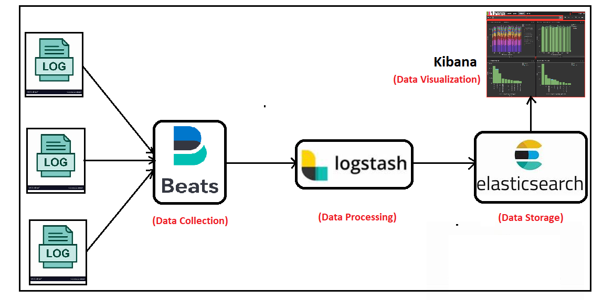
Elastic Stack Components

Slide 12
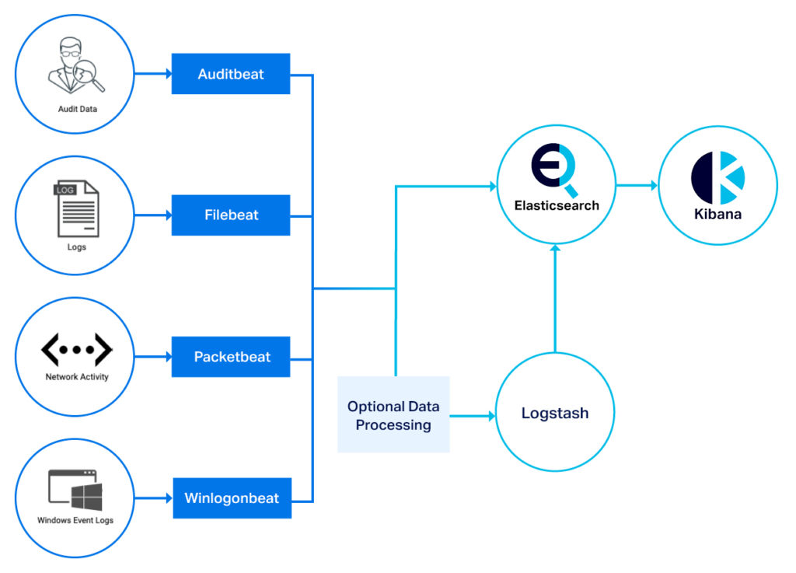
Elastic Beats

Slide 13
Elastic Beats
Elastic Beats are a series of different data shippers that are set up and configured to send data from a server/computer into Elasticsearch—either directly, or via Logstash.
There are different types of beats maintained by Elastic like Metricbeat, Winlogonbeat, Filebeat, Packetbeat, Auditbeat and Heartbeat.
A data shipper is exactly what it sounds like: The shipper (a Beat) ships data (e.g. contents of a log file, metrics on a system, network activity, etc.) to Elasticsearch or Logstash in real time.
There is very little configuration and very little data manipulation you can do in a Beat. It just sends the data somewhere else for processing.

Slide 14
Thank you!!

